Slide 1
President Trump’s Tweet Sentiment Analysis

Slide 2
President Trump has been known for using Twitter far more than most world leaders which often caused a lot of controversy

Slide 3
Tools Used
NLP Analysis: NLTK, TextBlob, Spacy
Visualization: Plotly, Seaborn, WordCloud
Modeling: PyTorch (RNN with LSTM)
Computing: Google Cloud Platform

Slide 4
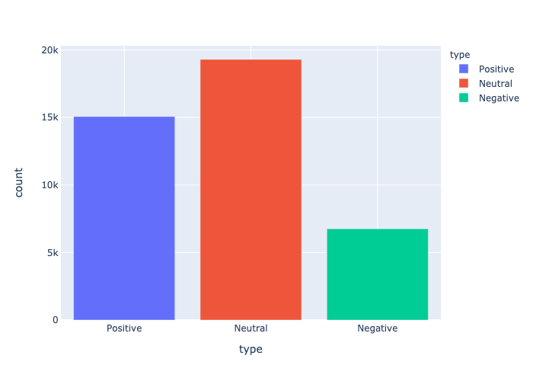
Breakdown by Sentiment
37% 47% 16%

Slide 5
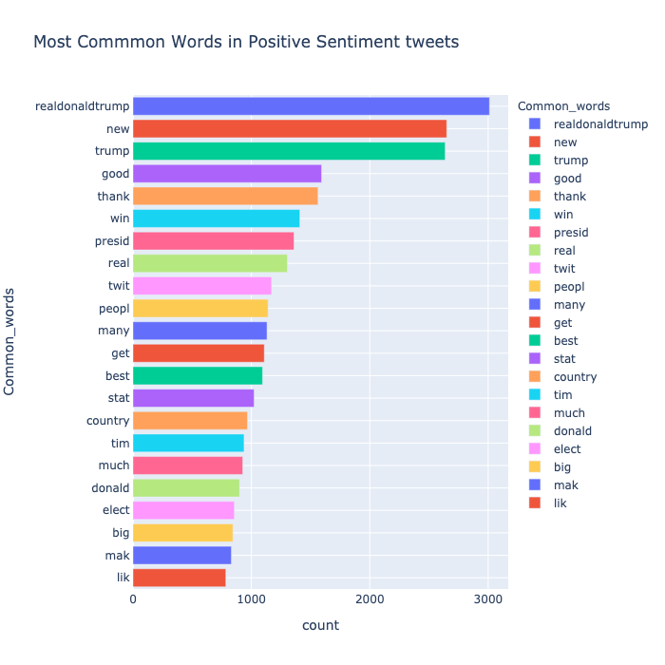
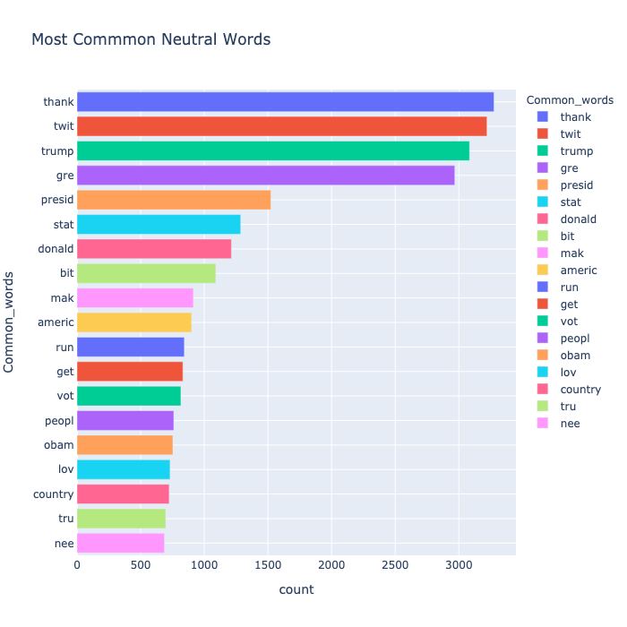
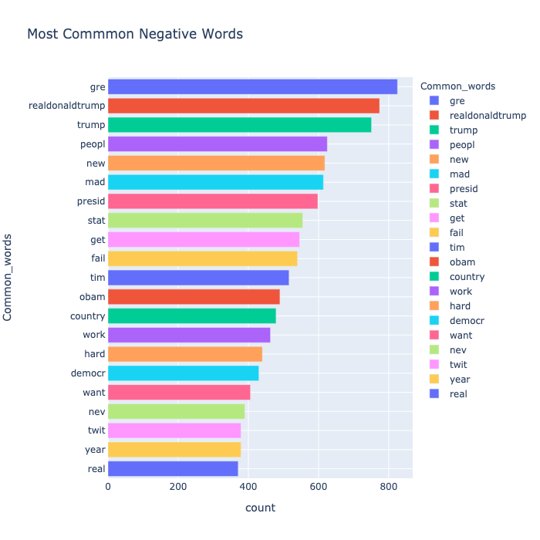
Common Words Used
Positive Neutral Negative

Slide 6
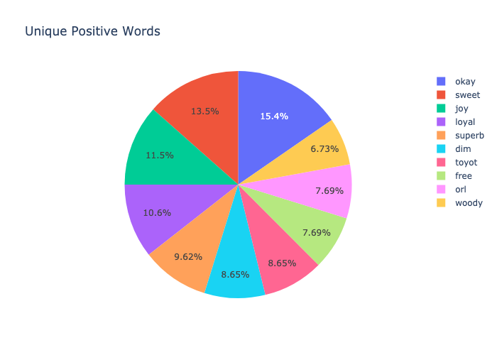
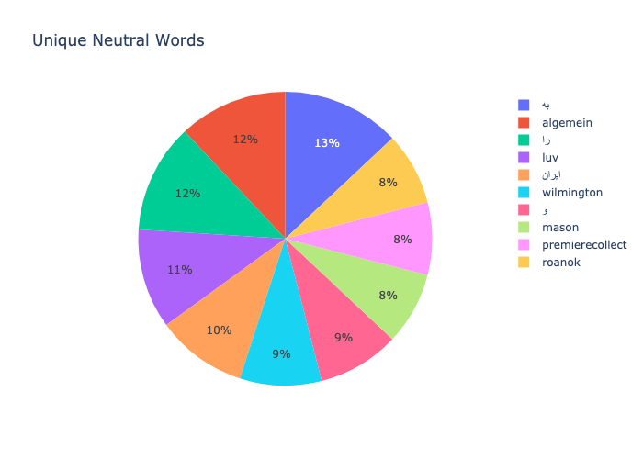
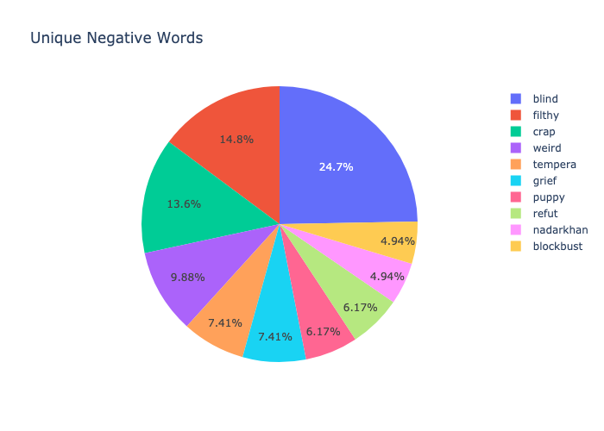
Words unique to each sentiment
Positive Neutral Negative

Slide 7
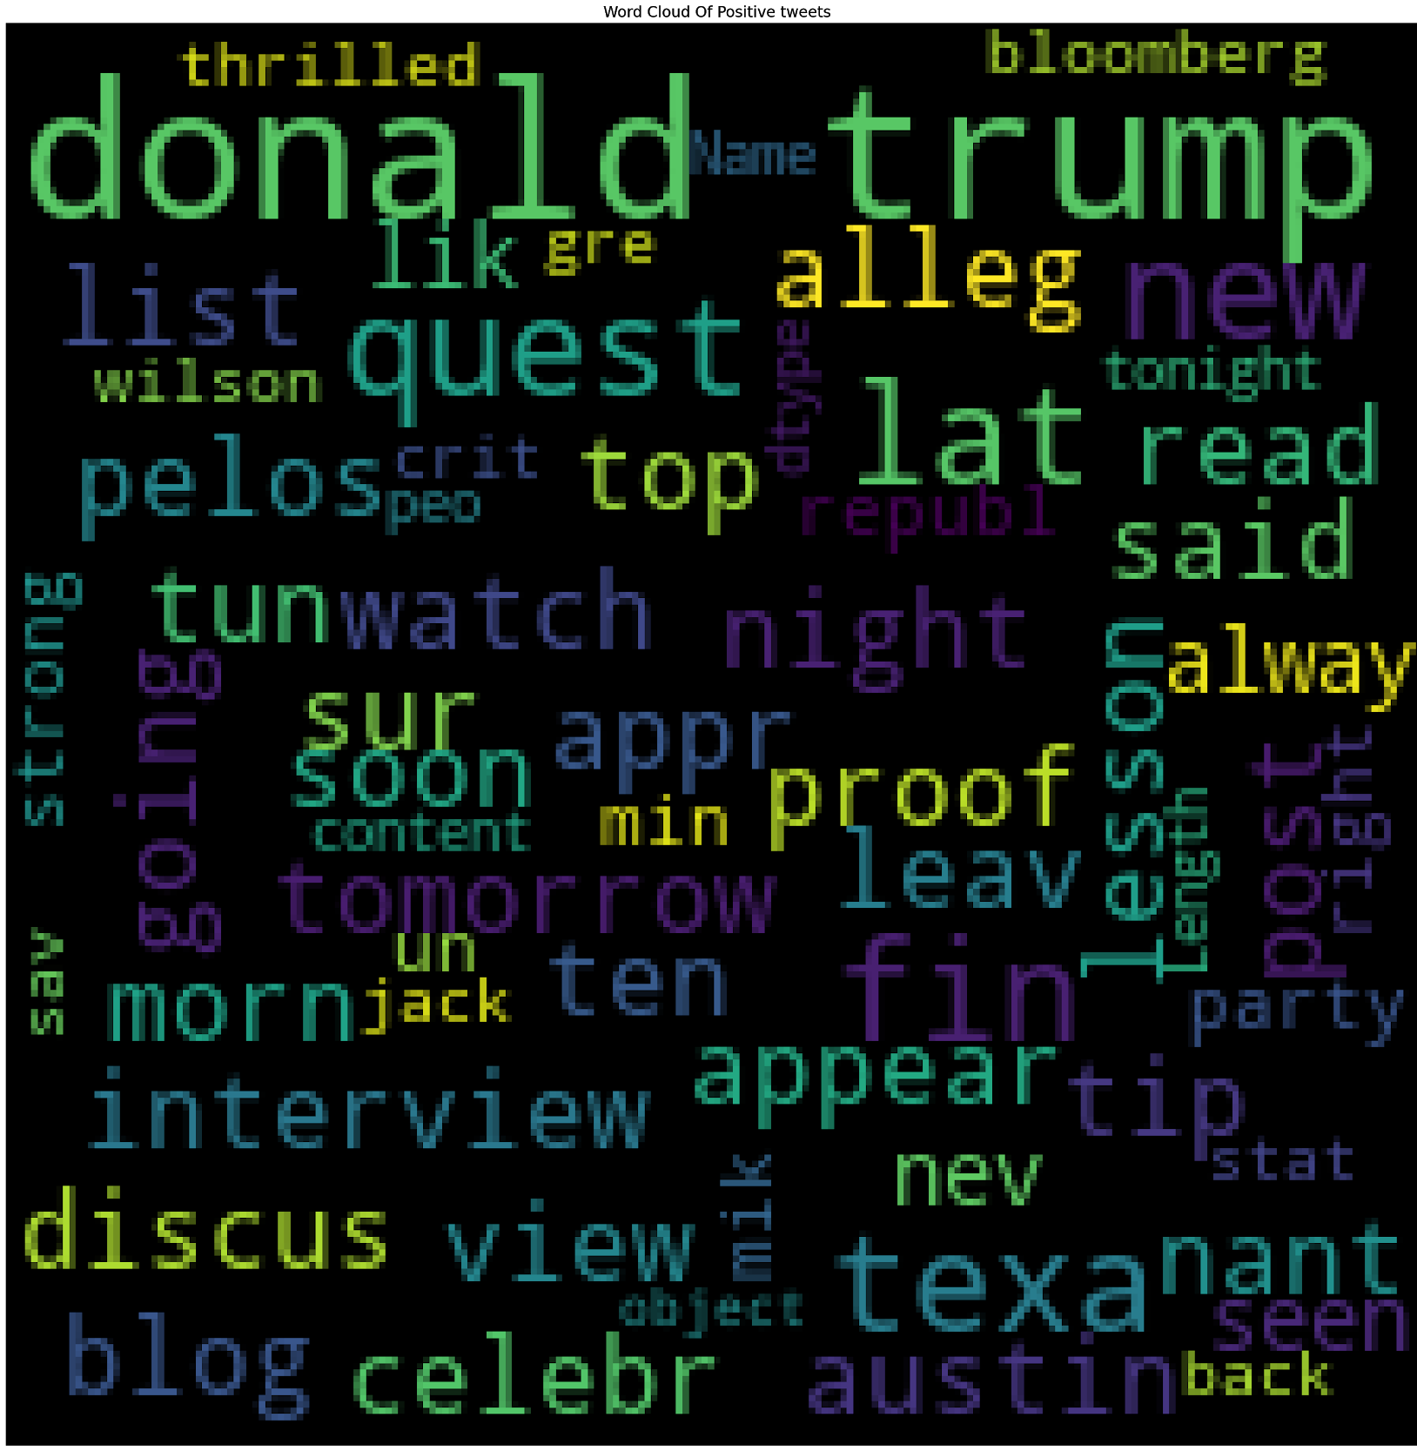
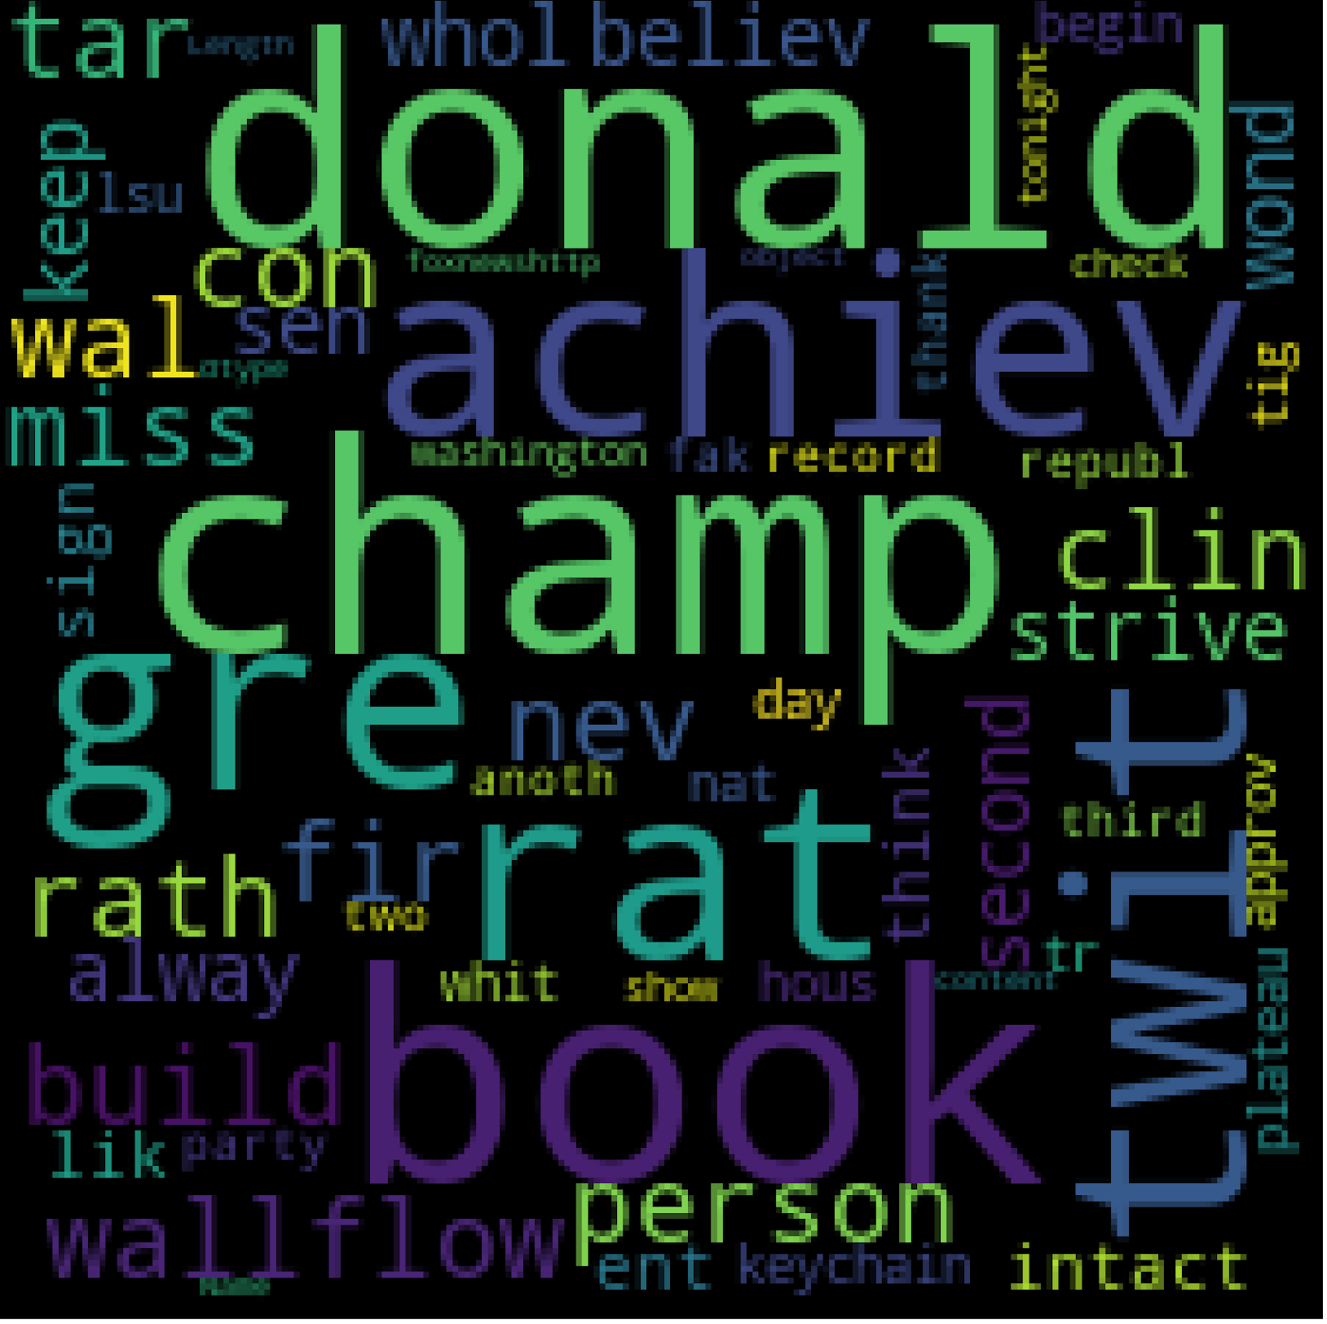
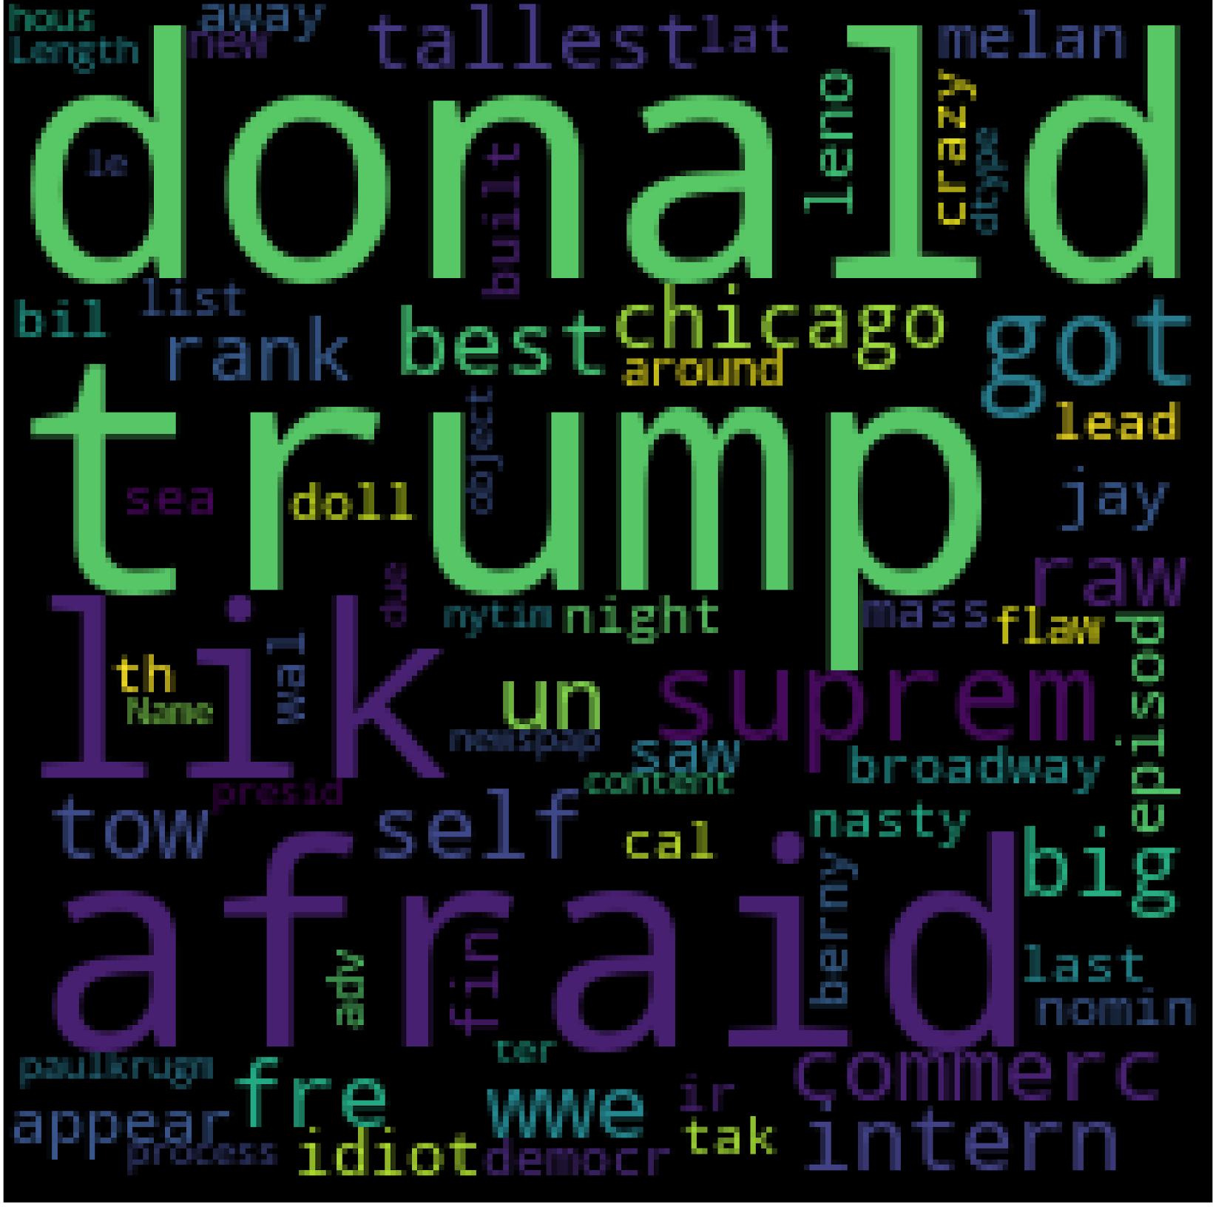
WordCloud
Positive
Neutral
Negative

Slide 8
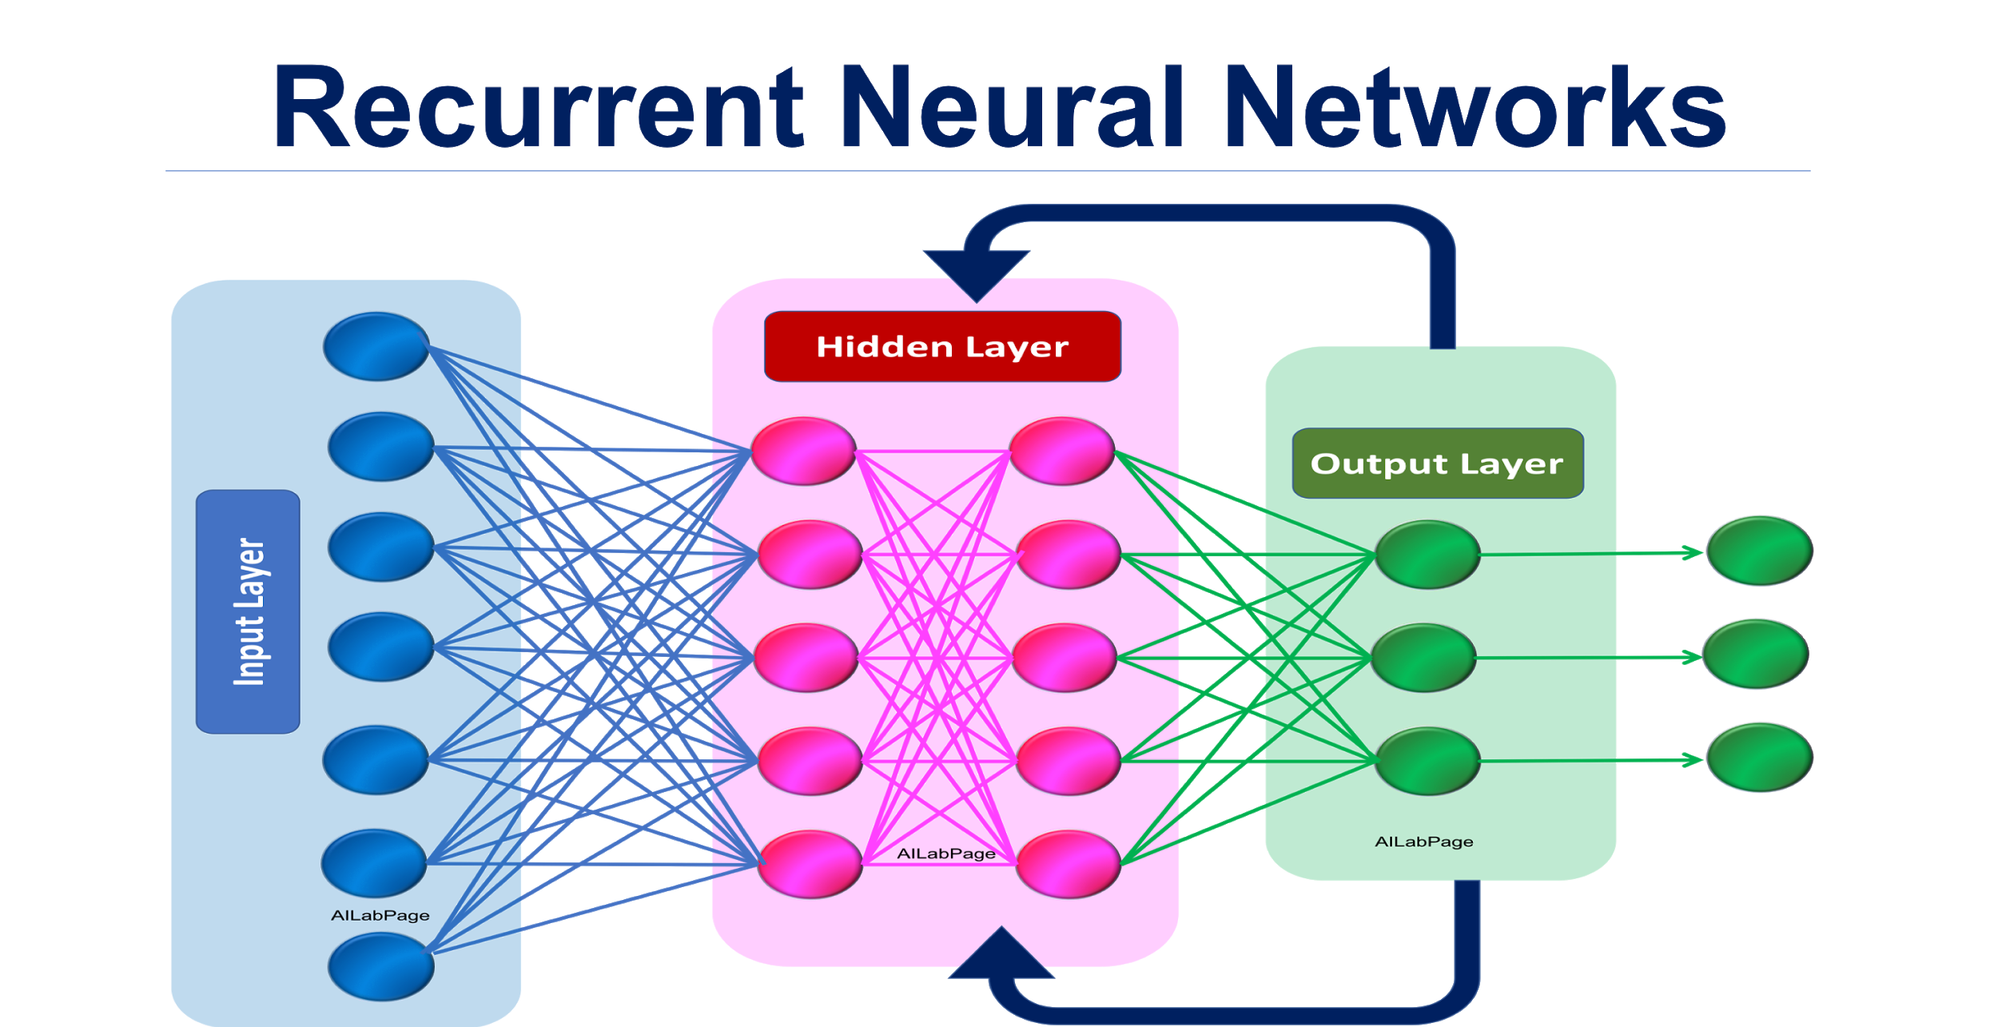

Sentence Predicition Model

Slide 9

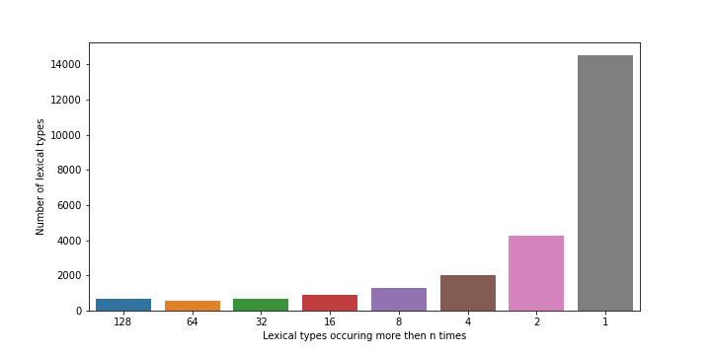
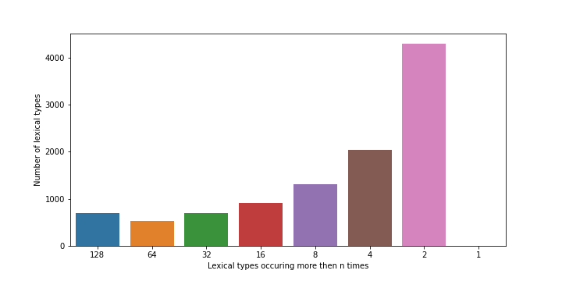
Stemming and dropping
Example of words dropped: choirboy, landform, sweepstake, bounty, چهلسالشکست, etc.

Slide 10
Sentence generation results.
Good:
Good became president obama total focus need make america great realdonaldtrump run president.
Good one best way realdonaldtrump plea run president country need lead thank.
Today:
Today see record via breitbart new donald trump leaving trump new york
Today meet story thank council michigan twit realdonaldtrump stat realdonaldtrump plea run
Afraid:
Afraid enough win real good country thank realdonaldtrump plea run president need
Afraid nuclear deal take place time realdonaldtrump plea run president need see

Slide 11
Thanks!
Any questions?
Project GitHub repo:
git@github.com:RamonMartin1//NLP_Project.git
Contact Email:
martin.ramon.f@gmail.com

